Slide 1
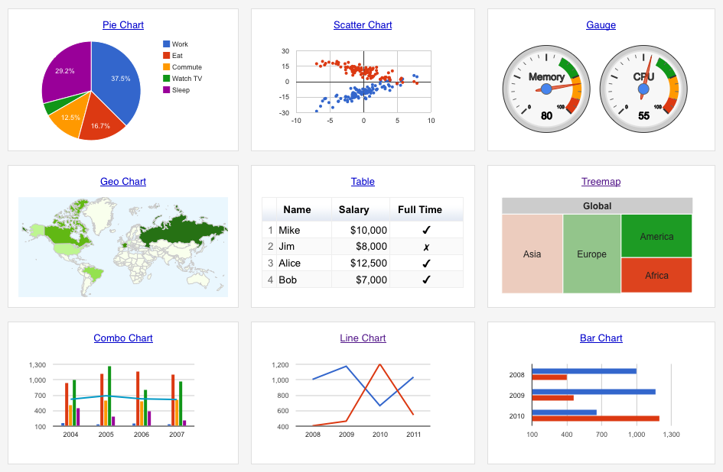
Google Charts
By:
Nicholas Lichtsinn

Slide 2

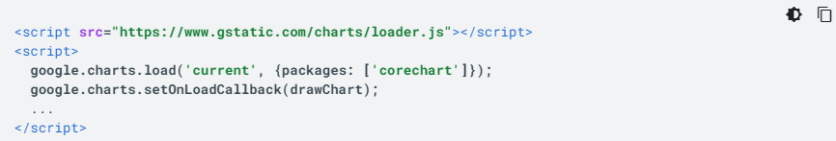
Features - summary
Charts in Google Sheets
Google Charts API
Building Dashboards in Google Sheets
Notes:
Charts from a google sheet (excel or csv file), similar to building charts in MS Excel
API allows the use of a Javascript embedded chart on a website
Dashboards in Google Sheets update in real time and are interactive, very useful for data that changes month to month

Slide 3
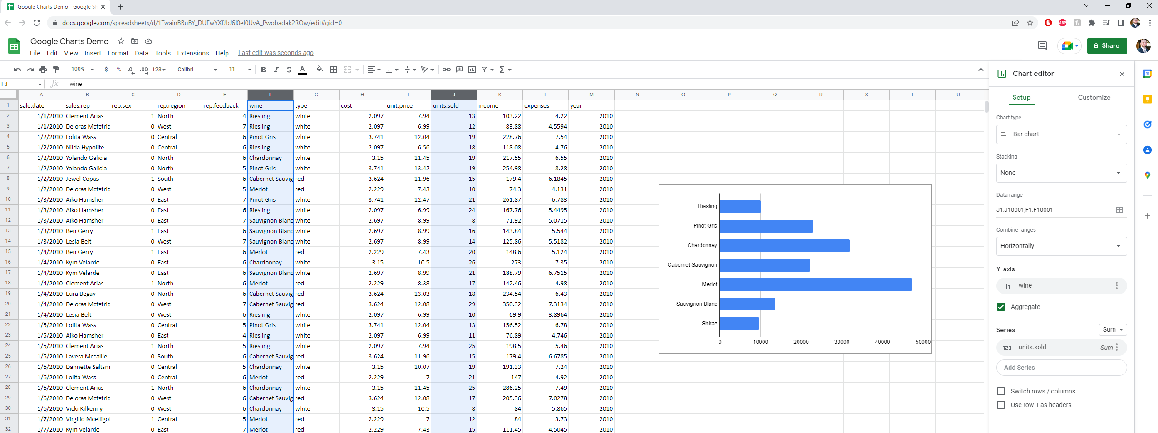
Setup

Slide 4
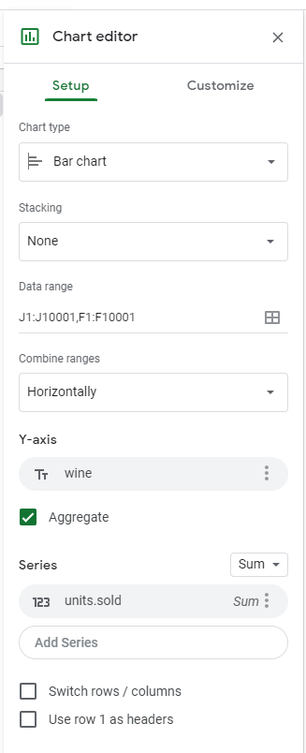
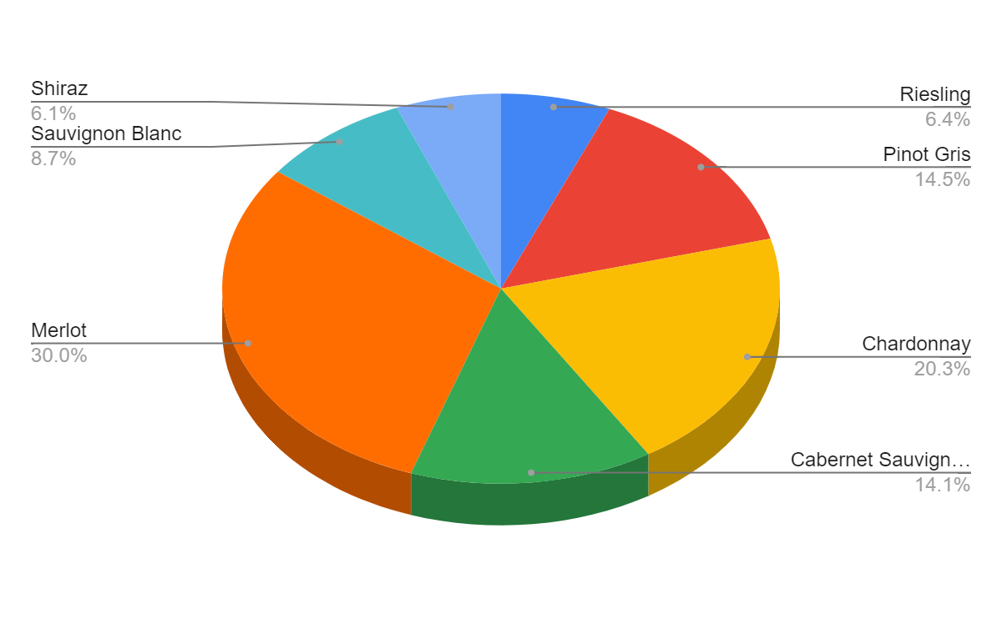
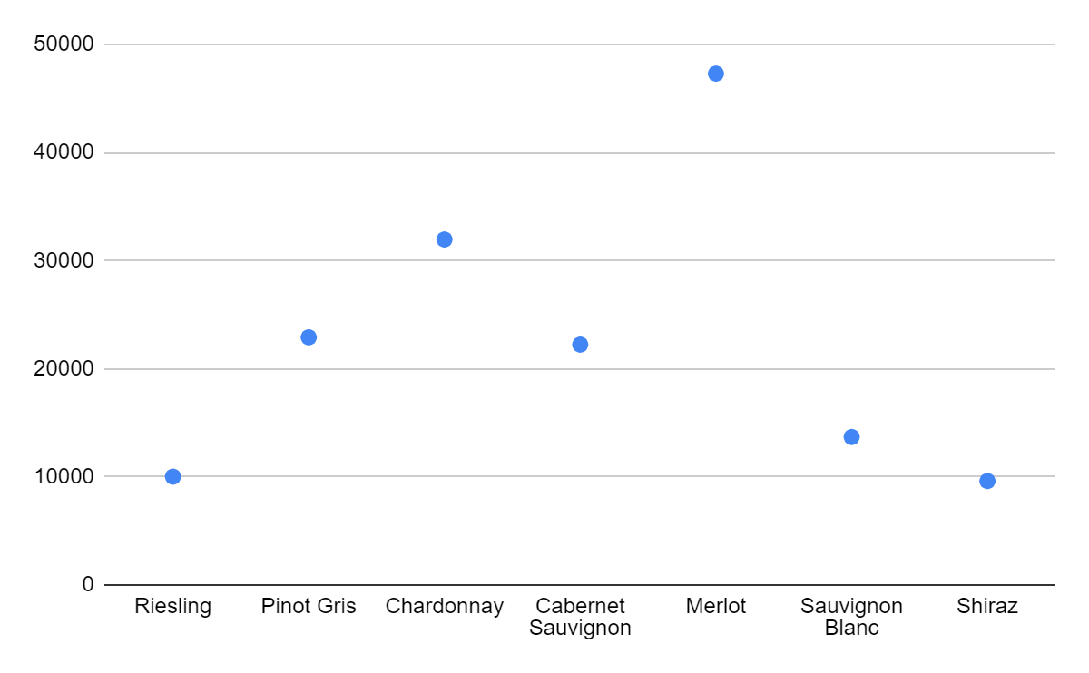
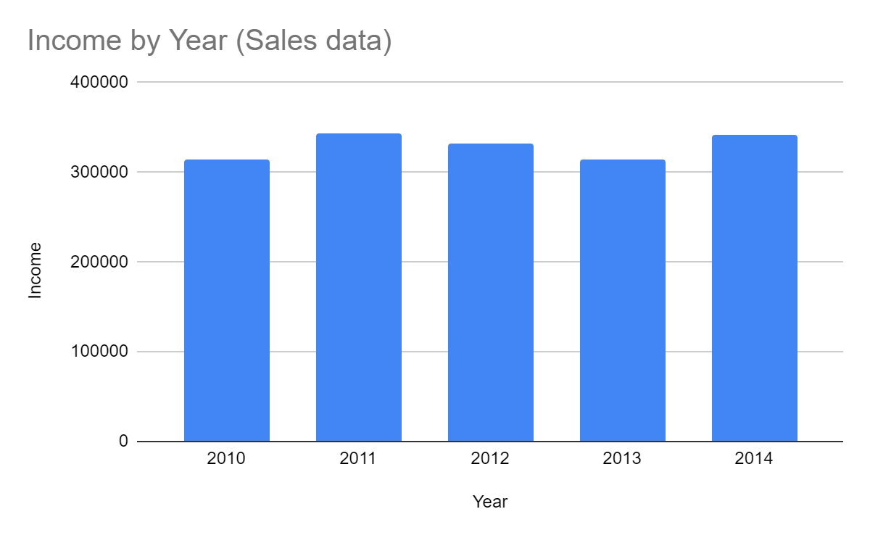
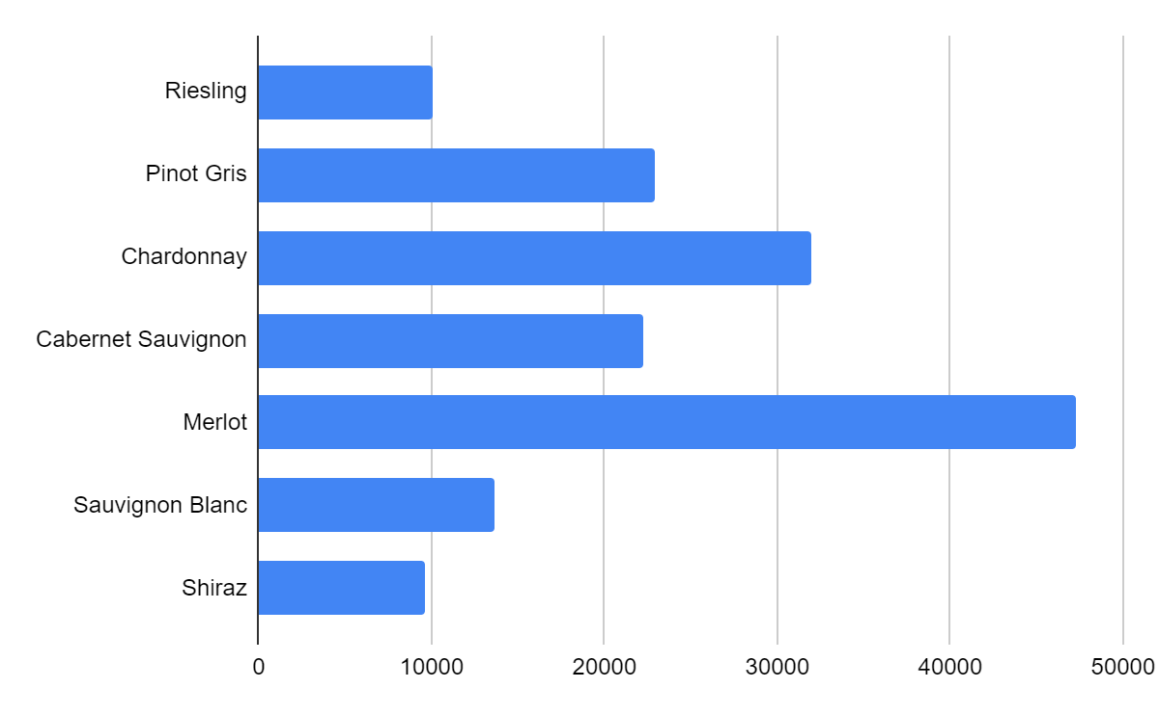
Functions / Capability

Slide 5
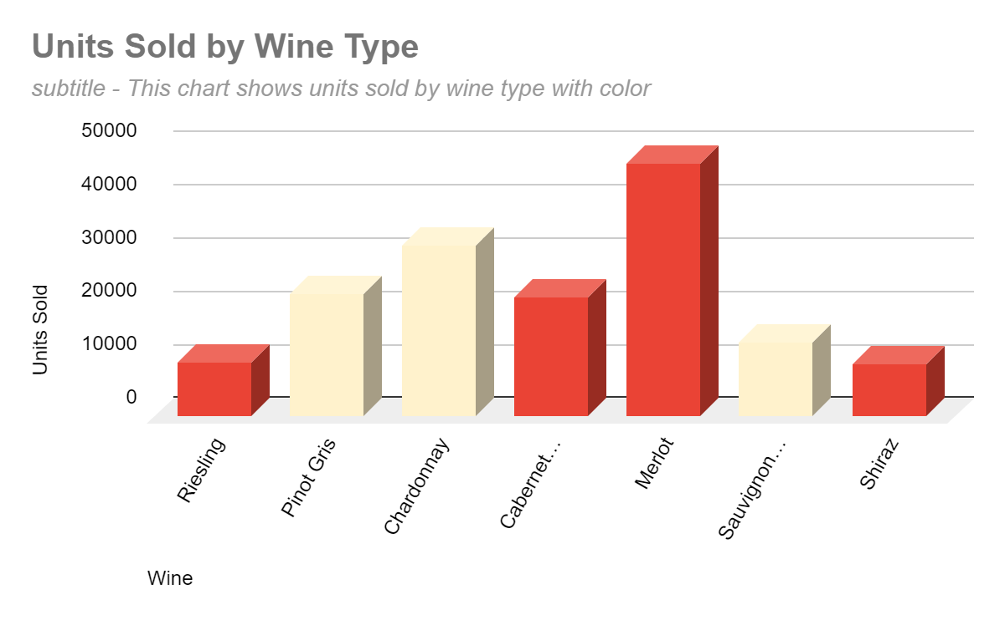
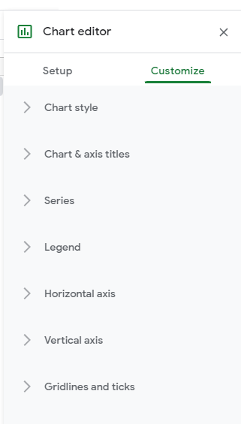
Functions/Capability
Chart Style
Chart & Axis Titles
Series
Legend
Horizontal & Vertical Axis
Gridlines & Ticks
Notes:
Chart Style – background color, font, border color, maximize layout, 3d or compare mode
Chart & Axis Titles – chart title, vert, horizontal and subtitle font, size, bold/italic and text color
Series – for each variable that is put into series in the setup you can change fill color, opacity, line type/thickness, the axis, aggregate type (mean, max, sum, count etc.), change specific colors of bars/lines
Legend – position, font, font size, bold/italicized and text color
Horizontal & Vertical Axis – label font, font size, bold/italics, text color, slant labels, if number can choose scale and format of numbers
Gridlines & Ticks – major/minor gridlines & ticks, spacing type/count for major and minor

Slide 6
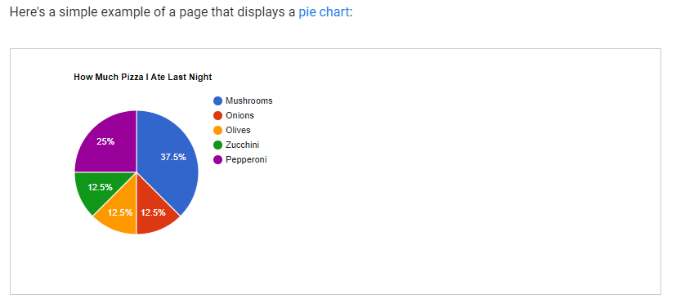
Google Charts API
Visualize data on a website
Large number of ready to use chart types
Most common way is to use JavaScript embedded in the web page
Notes:
- Create a Datatable in javascript, that is used with the various chart types to display the information in an interactive way.

Slide 7

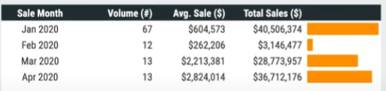
Google Sheets ‘Query’ Function
=QUERY(Sheet1!1:10001, "select B, sum(J) group by B")
Scorecard
Sparkline
Notes:
- building tables with data that is updated constantly
- Created using query to build off the sheet with all of the data
- choose columns
- dropdown menus
- conditional formatting
- QUERY formula
- charts
- helper columns, month, year
- scorecards – main info sum of things at top
- sparkline – min chart inside of a cell

Slide 8
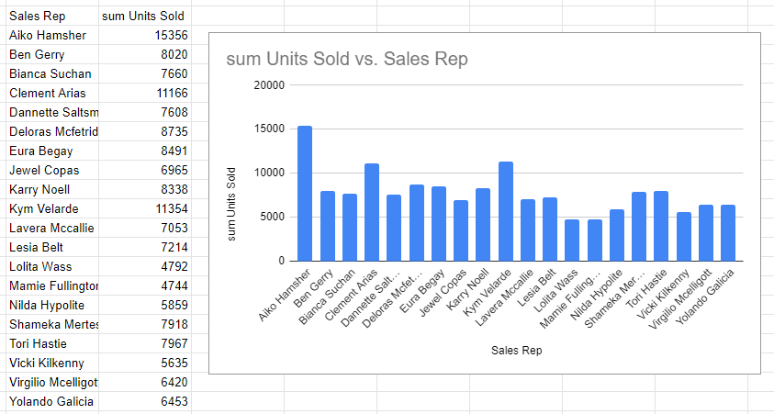
Creating a Dashboard

Slide 9
Learning Curve
Overall easy to learn
Some prior knowledge of JavaScript would be very helpful
Google sheets charts and dashboards very robust and user friendly

Slide 10
Thank you!
Google Charts
By: Nicholas Lichtsinn

